Slide 1
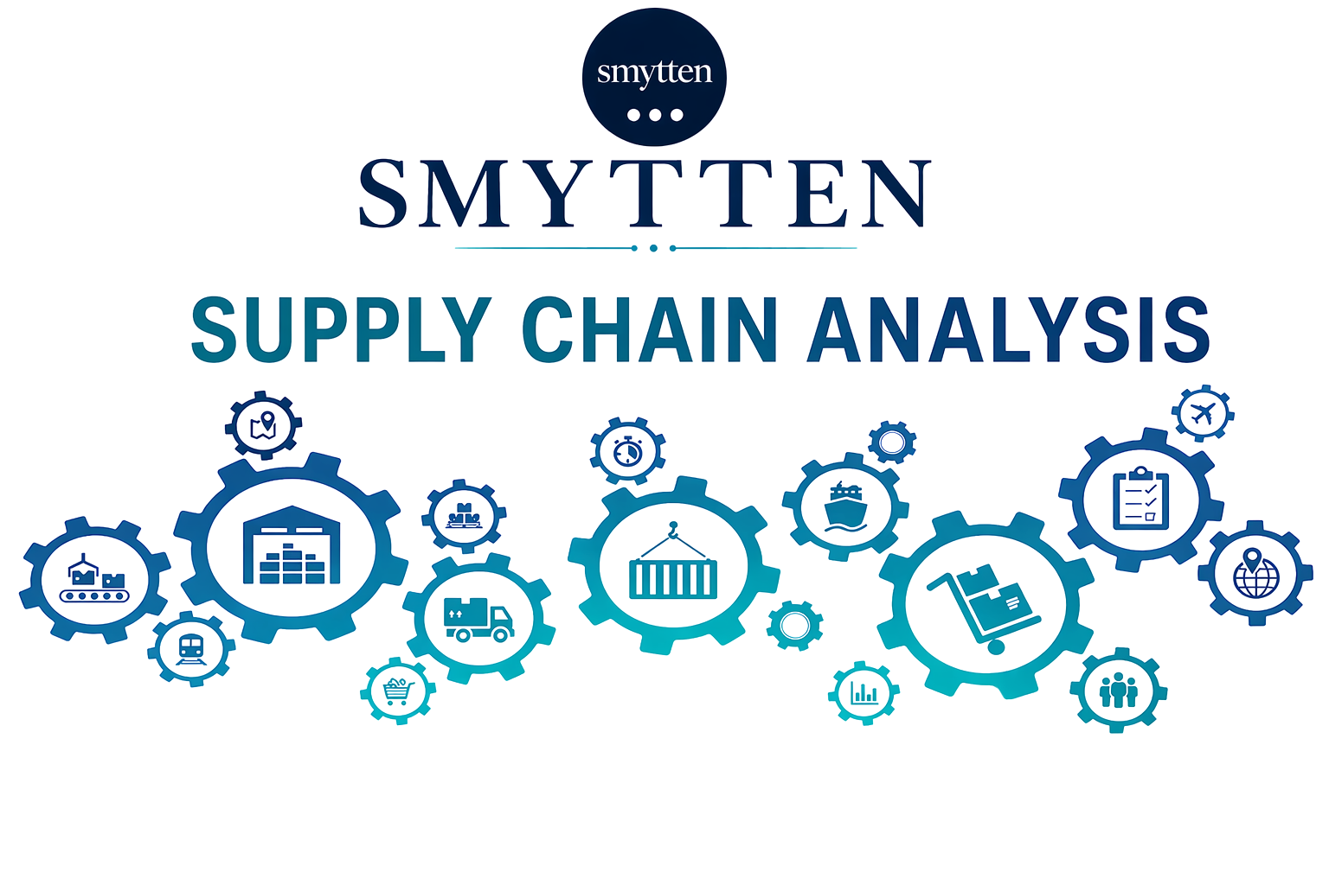
Prepared By
Sahana Srinivasa

Slide 2







Objective
Diagnose Quality & Inventory Control Issues
Analyze end-to-end supply chain across 100 SKUs
Drive Data-Driven Prescriptive Actions for Business Growth
Analyze Financial Health & Revenue Risk Exposure

Slide 3

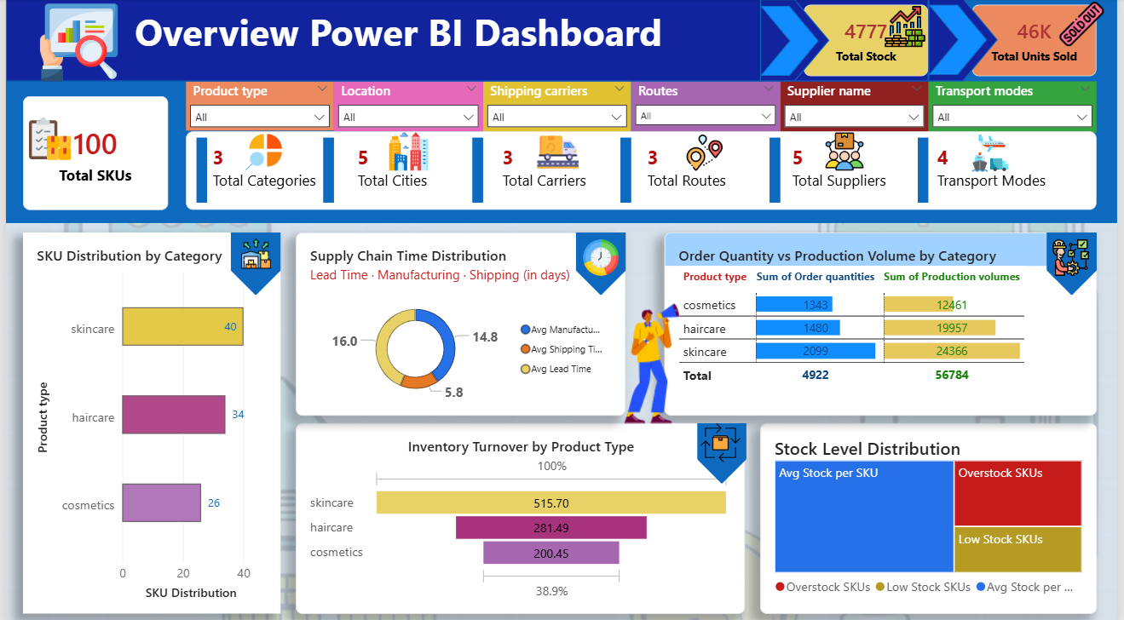
Overview Dashboard

Slide 4

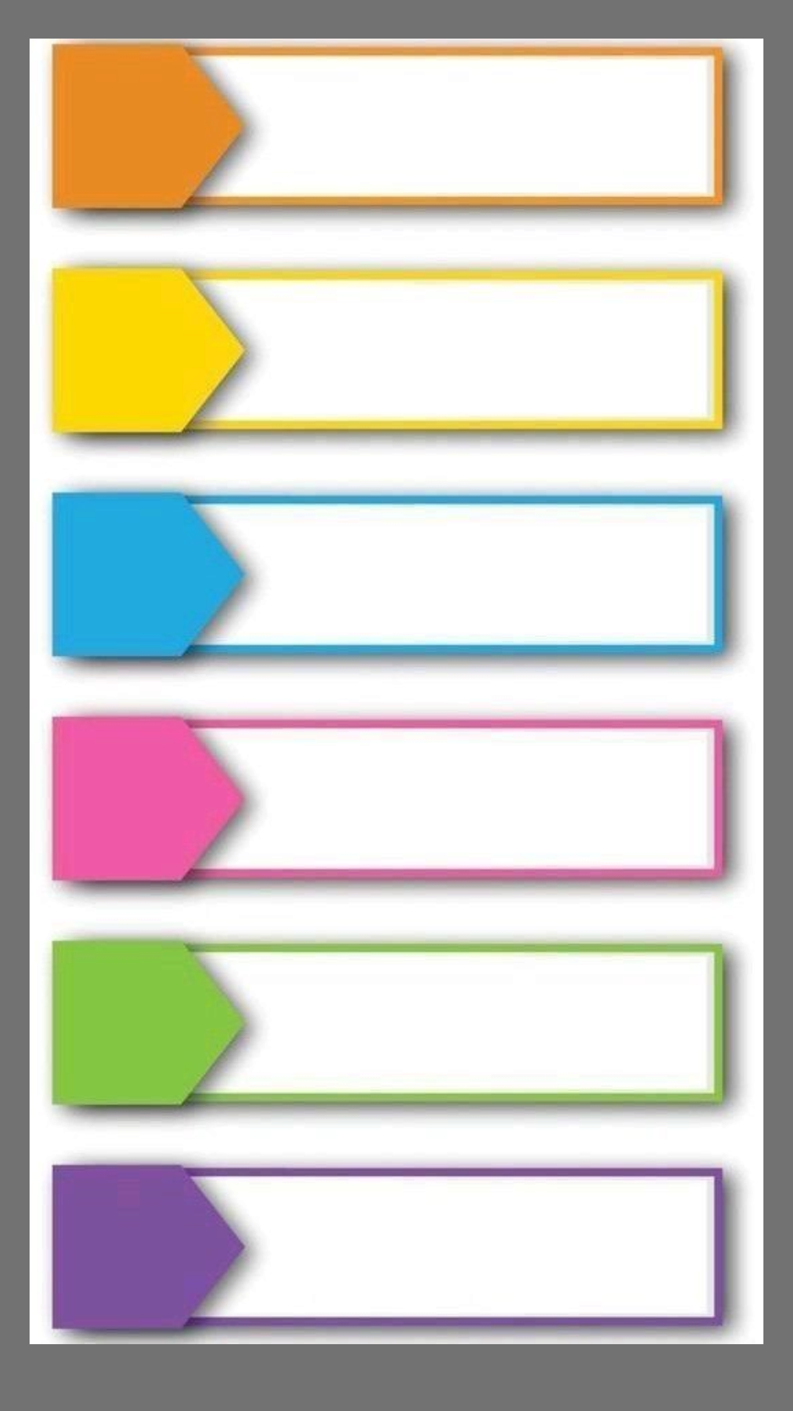
Executive Summary
Revenue & Profitibility
The dataset reflects $577K in revenue with a healthy 90% profit margin — well above the industry average of 72%
Revenue at Risk
Nearly half the total revenue ($273K) is at risk — driven by quality inspection failures and critically low stock levels
Quality Control Crisis
Only 23 out of 100 SKUs have passed quality inspection — 77 are either failed or pending review, signaling a systemic quality gap
Delivery delays
Average fulfillment time stands at 17 days — with 14.8 days consumed in manufacturing alone, leaving minimal buffer for delivery
Recovery Opportunity
Route optimization, stock replenishment and quality fixes present a clear opportunity to recover up to $125K in revenue
Strategic Recommendation
Prioritizing quality control and inventory management delivers the highest return on the lowest investment across this supply chain

Slide 5

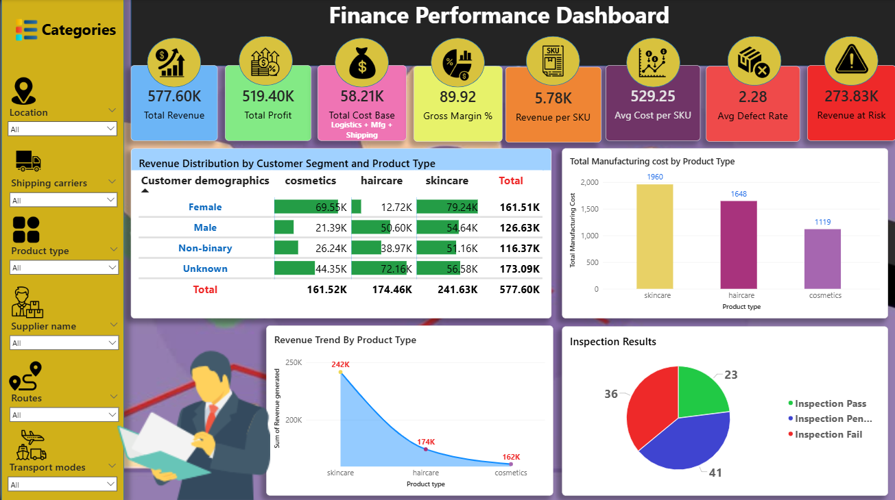
Finance Overview

Slide 6

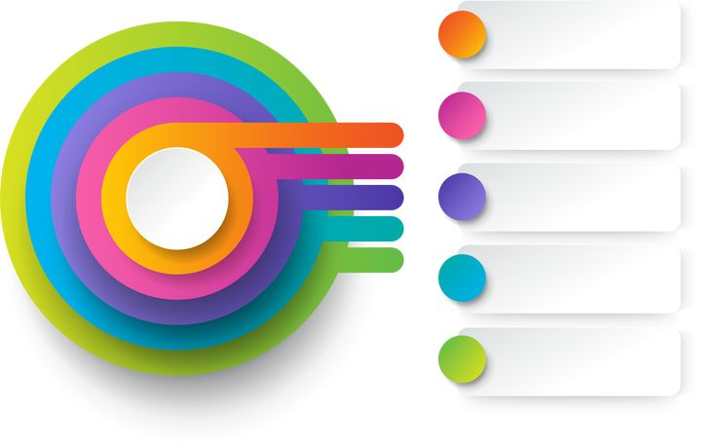





Supply Chain Performance
14 SKUs are at stockout risk - critically low stock threatening immediate sales loss
significant overproduction
32 SKUs carry a defect rate above 3% — directly impacting product reliability and returns
Inventory & Stock
Quality & Inspection
Average shipping time is 5.8 days across Road, Air, Rail and Sea transport modes
Fulfillment & Lead Time
Supplier Performance
Logistics & Routes
5 suppliers assessed across defect rates, lead times and order volumes
Supplier quality gaps are the primary driver of inspection failures
37 SKUs on Route B are overpaying by 23%
Switching routes saves $4,107 per cycle — zero operational disruption required

Slide 7





Finance Performance
$273K (47% of revenue) is at risk from failed inspections and stockouts — immediate priority
Total revenue of $577K at a 90% gross margin — 18 points above the 72% industry benchmark
Route optimisation and quality fixes can unlock $90K–$125K in recoverable revenue
Cosmetics has the best margin (87.3%) · Skincare drives highest total revenue (42% share)
Top 10 SKUs drive disproportionate revenue — bottom 10 SKUs need urgent performance review
Logistics accounts for 91% of total costs — the dominant and most controllable cost driver

Slide 8


Root Cause
Failed inspections and low stock levels are occurring simultaneously — no early warning system exists to flag at-risk SKUs before revenue impact
Production volumes are not aligned to demand signals — manufacturing runs on fixed schedules rather than order-driven planning
Revenue at Risk ($273K)
Overproduction
(56K units vs 4.9K orders)
Defect concentration linked to specific suppliers — quality gaps at source are not being caught before products enter the supply chain
Manufacturing consumes 86% of total lead time — bottleneck is at production, not logistics, making delivery speed impossible to improve without fixing manufacturing first
High Defect Rate (32 SKUs above 3%)
High Lead Time
No standardized inspection threshold across suppliers — each supplier operates with different quality benchmarks, driving inconsistent defect rates
Route selection is not cost-optimized — 37 SKUs on Route B are paying 23% more with no performance advantage over Route A
Quality Failures
(36 Failed | 41 Pending)
Suboptimal Routing (Route B overused)

Slide 9

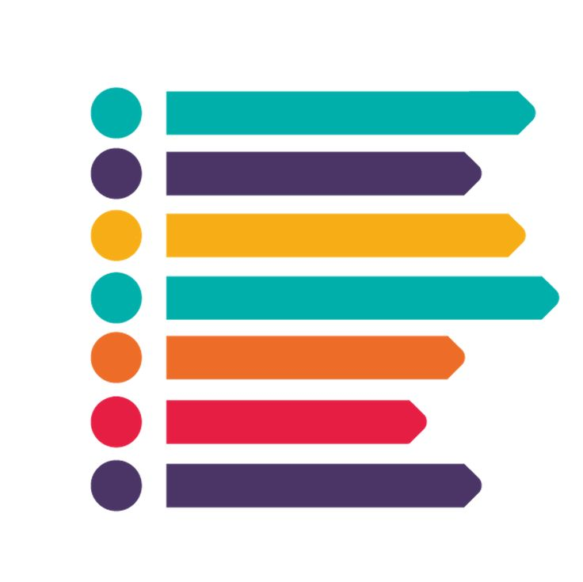



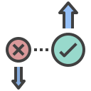


Recommendations and Conclusion
Enforce 3% defect threshold across all suppliers — non-compliant suppliers on immediate probation
Switch 37 SKUs from Route B to Route A — saves $4,107 per cycle, zero disruption
Implement real-time inventory monitoring — stockout alerts should trigger automatic replenishment orders before stock hits critical levels
Migrate all eligible shipments to cost-efficient routing — current routing decisions are costing the business unnecessarily with no service advantage
Make inspection clearance mandatory before dispatch — no SKU should reach the market without a confirmed Pass status
A 90% gross margin business is being undermined by avoidable operational failures in quality and inventory
47% of total revenue ($273K) remains at risk until quality control and stock management are overhauled
The supply chain has the foundation to scale — but only after inspection, routing and production discipline are enforced
CONCLUSION

